Slide 1


ಓಂ ಶ್ರೀ ಗುರುಬಸವ ಲಿಂಗಾಯ ನಮಃ
Visvesvaraya Technological University
“Jnana Sangama”,Belagavi
SVE SOCIETY’S
Bheemanna Khandre Institute Of
Technology, Bhalki.
Department of Electronics and Communication Engineering
A Project Presentation on
“HOTEL MANAGEMENT SYSTEM”
BY-
BASAVAKIRAN 3RB19EC013
ASHISH 3RB19EC009
M SUBHASH 3RB19EC034
GAJANAND 3RB19EC020
Sub. Code : 18ECP83
Under The Guidance of
Dr. Prashant S

Slide 2
Contents
Introduction
Project Objective
Features of Project
Advantages
Software and Hardware Requirements
Module Overview
Class Diagram
Flowchart
Application Snapshots
Future Scope
Conclusion
Reference

Slide 3
Introduction
This Project is just an overview of management in hotels
It manages and maintains the records of customers, rooms, employees and drivers in the hotel.
The project is aimed to maintain the day-to-day state of admission/vacation of Residents, List of employees, room details etc.
Main objective of this project is to provide a solution for hotels to manage most their work using computerized processes.
This software application will help admin to handle customer information, room allocation details, Payment details etc

Slide 4
Project Objective
The objective of the Hotel Management System is to develop a project which maintains booking of rooms, providing drivers, etc. It is a windows based application to be implemented in Java
The Purpose of the whole process is to ease the daily or regular activities of the Hotel Management into an automatic computerized retrievable process.
This software application will help admin to handle customer information, room allocation details, Payment details etc.
The Facilities provided by hotels are fully utilized in an effective and efficient manner.

Slide 5
Features of Project
Hotel Room Bookings and Reservation
Front Desk Operations
Managing Guest Profile
User Privilege and security control
Keeping a tab on guest check-in check-out status
Maintenance of hotel rooms.
Providing a user friendly interface.

Slide 6
Advantages
Sometime it happens that the rooms get booked soon when one visits the place therefore user can make advance booking using this system.
It saves user time in searching a room.
The system is useful as it calculates an exact cost of rooms for requested number of days.
It saves organization resources and expenses.
This system is effective and saves time and cost of users.
It is less time consuming and provides maximum accuracy.

Slide 7
Software and Hardware Requirement
Software Requirements:
Operating System Windows 10
Front End Java, Eclipse IDE
Back End MySQL
Hardware Requirements:
Desktop PC or a Laptop
Intel® CoreTM i3-6006U CPU @ 2.00GHz
4.00 GB RAM
64-bit operating system, x64 based processor
1024 x 768 monitor resolution
Keyboard and Mouse

Slide 8
Module Overview
System Modules
Admin Module:
Add Employee
Add Rooms
Add Drivers

Slide 9
2. Reception Module:
New Customer Form
Rooms
Department
All Employees
Customer info
Manager Info
Check out
Update Status
Update Room Status
Pickup Service
Search room
Logout

Slide 10
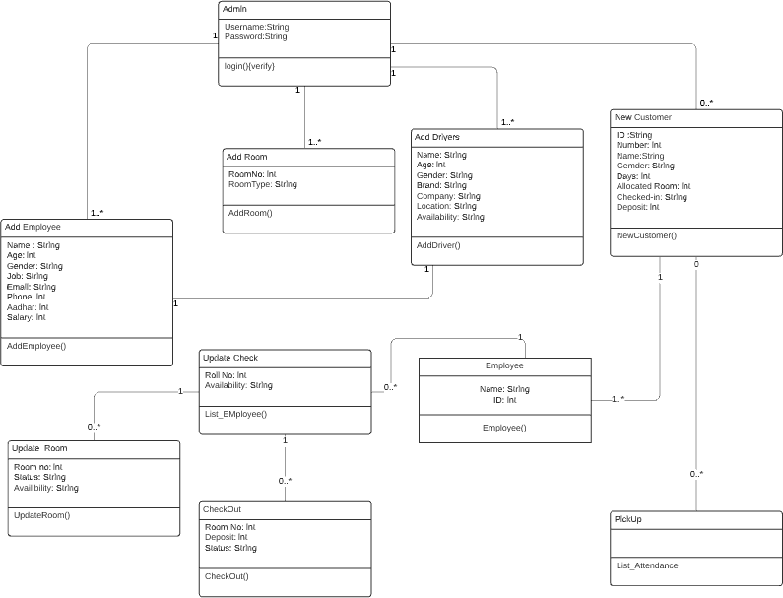
Class Diagram

Slide 11
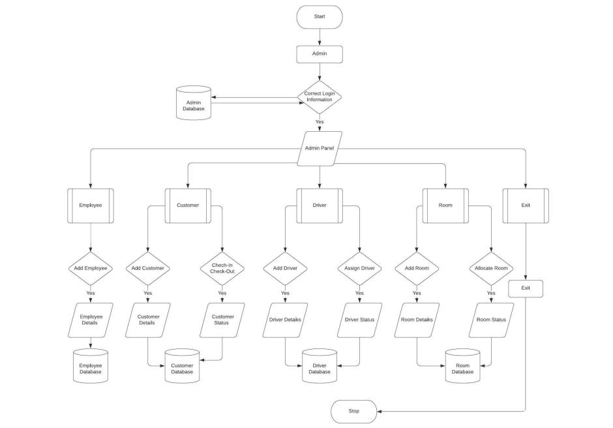
Flowchart

Slide 12

Application Snapshots
Main Page

Slide 13
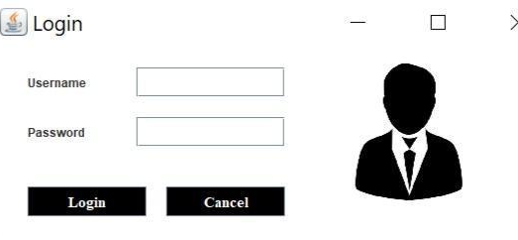
Login Page

Slide 14
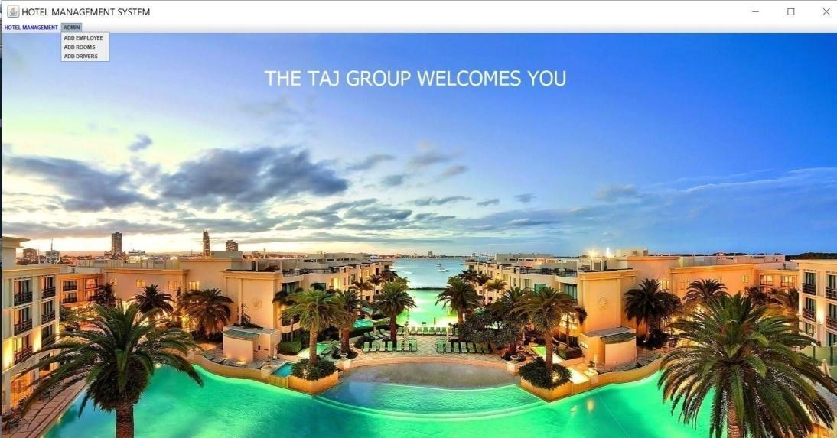
Dashboard

Slide 15
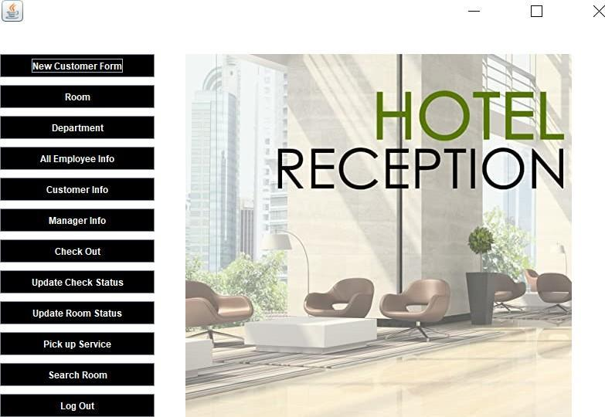
Reception

Slide 16
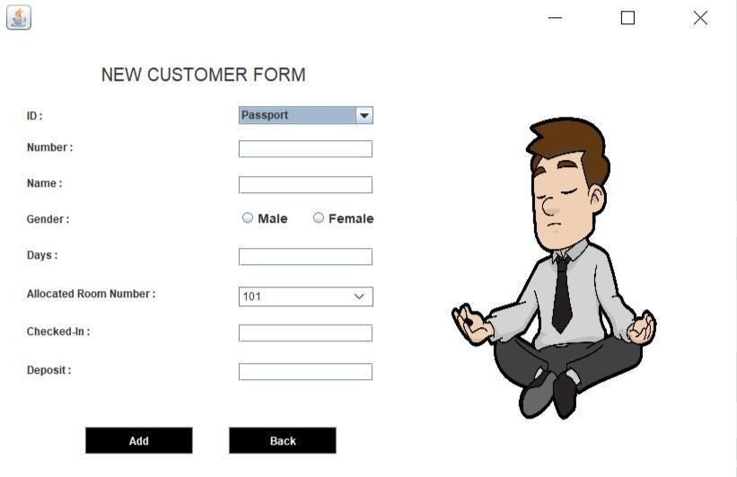
New Customer Form

Slide 17
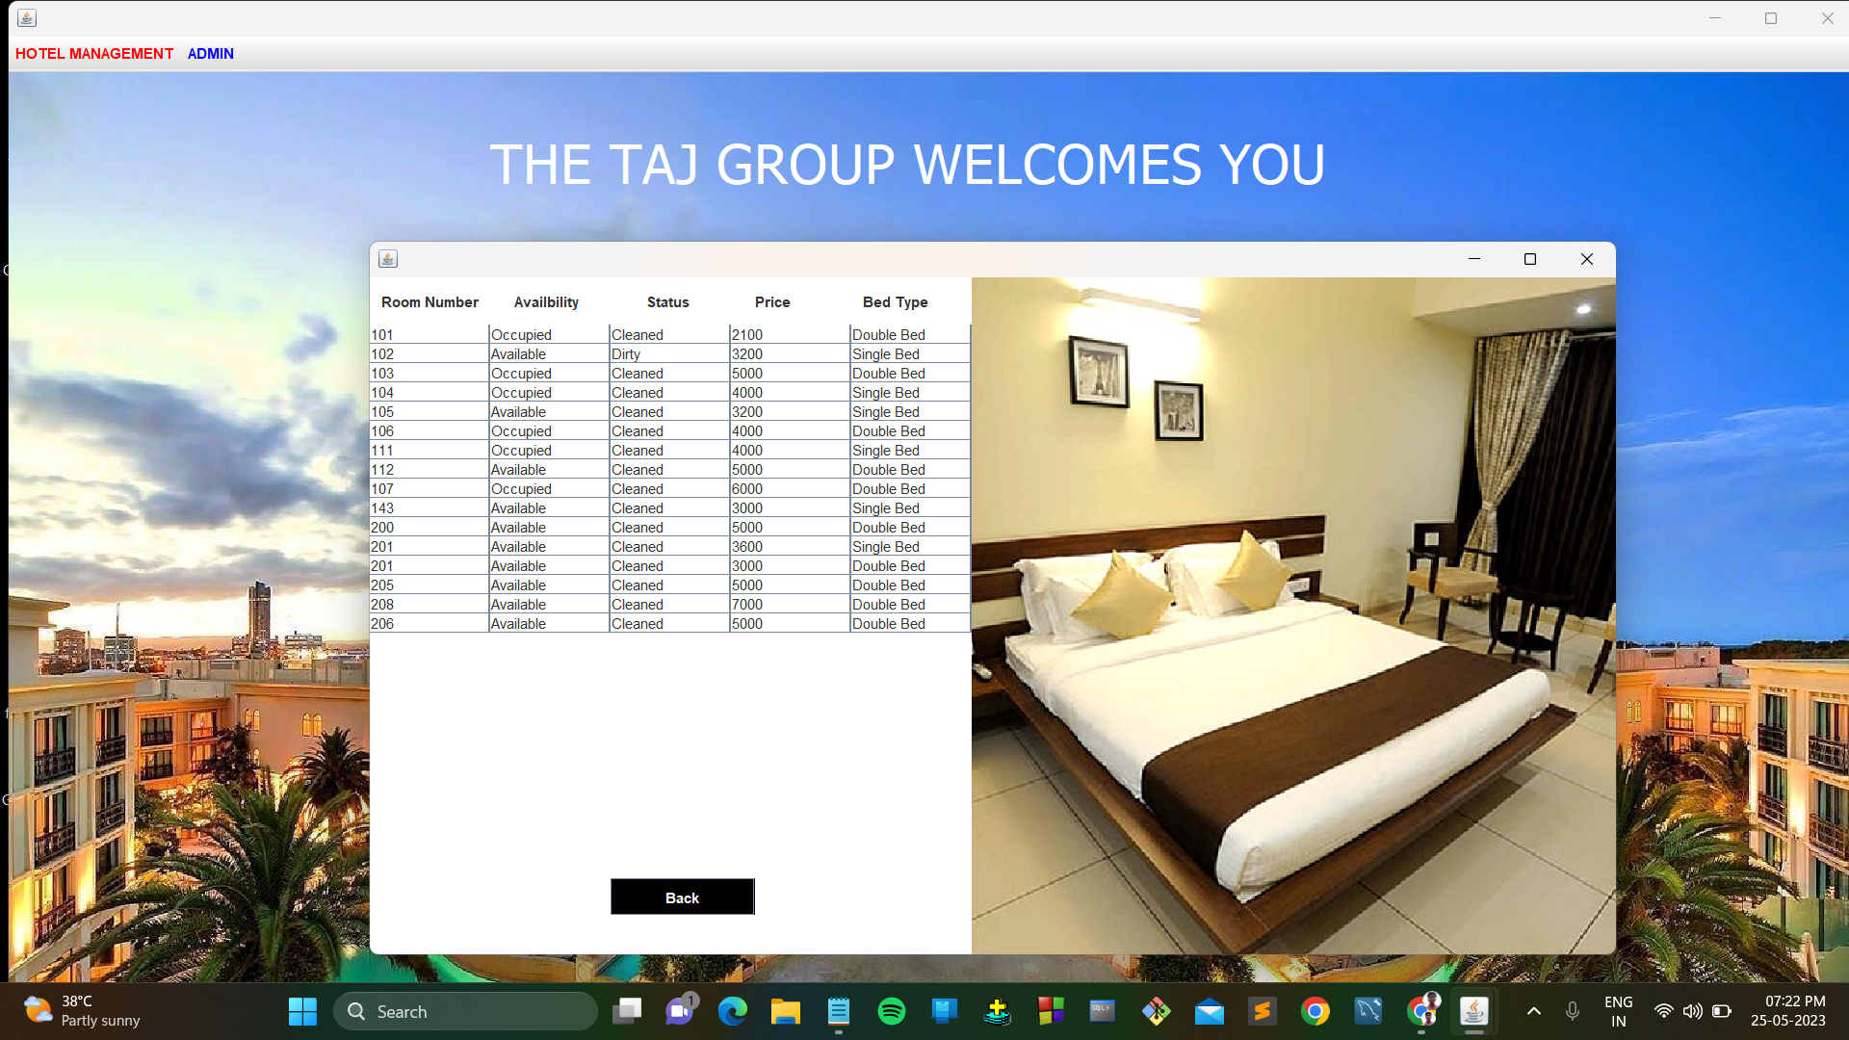
Rooms

Slide 18
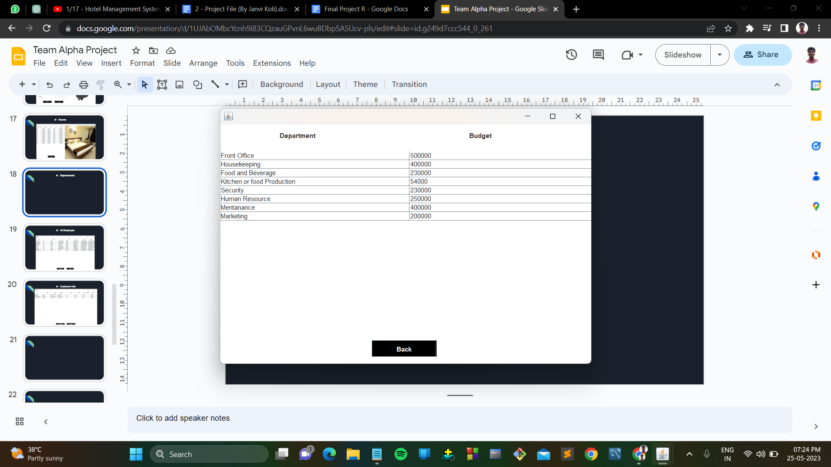
Departments

Slide 19
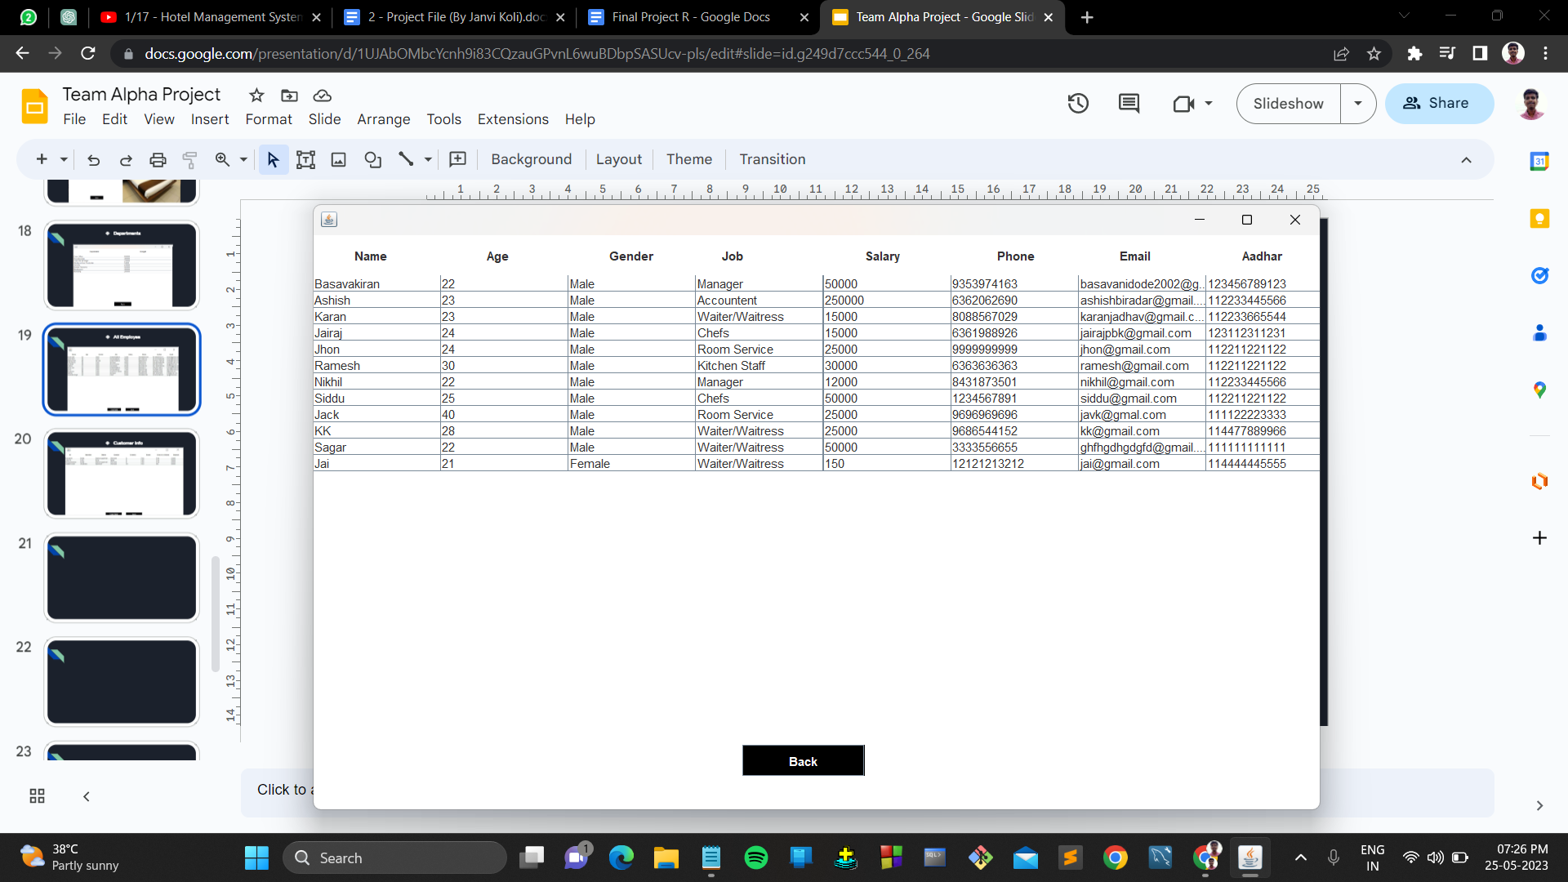
All Employee

Slide 20
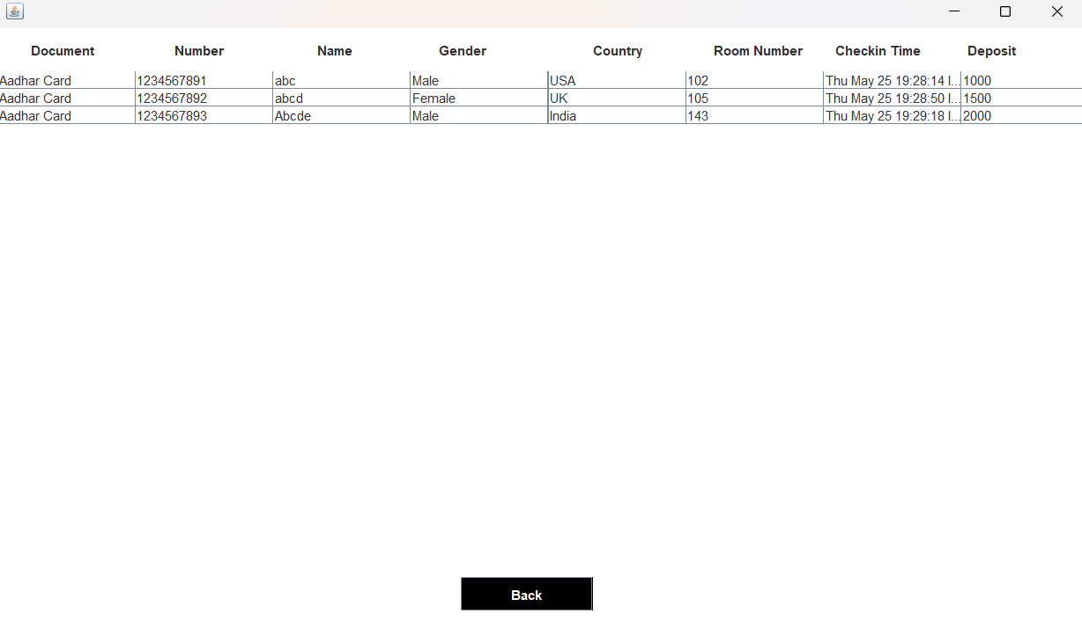
Customer Info

Slide 21
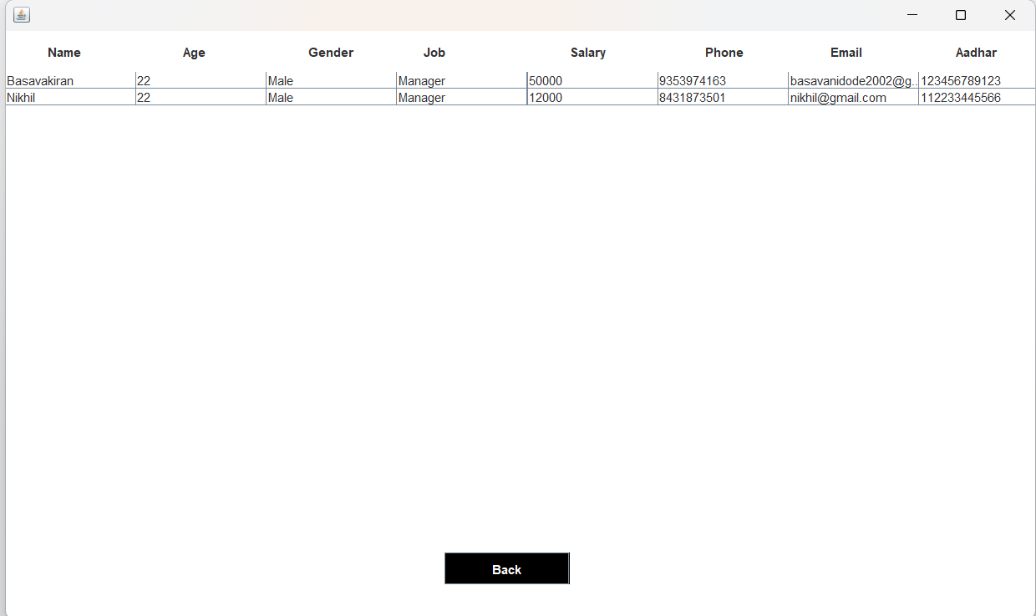
Manager Info

Slide 22
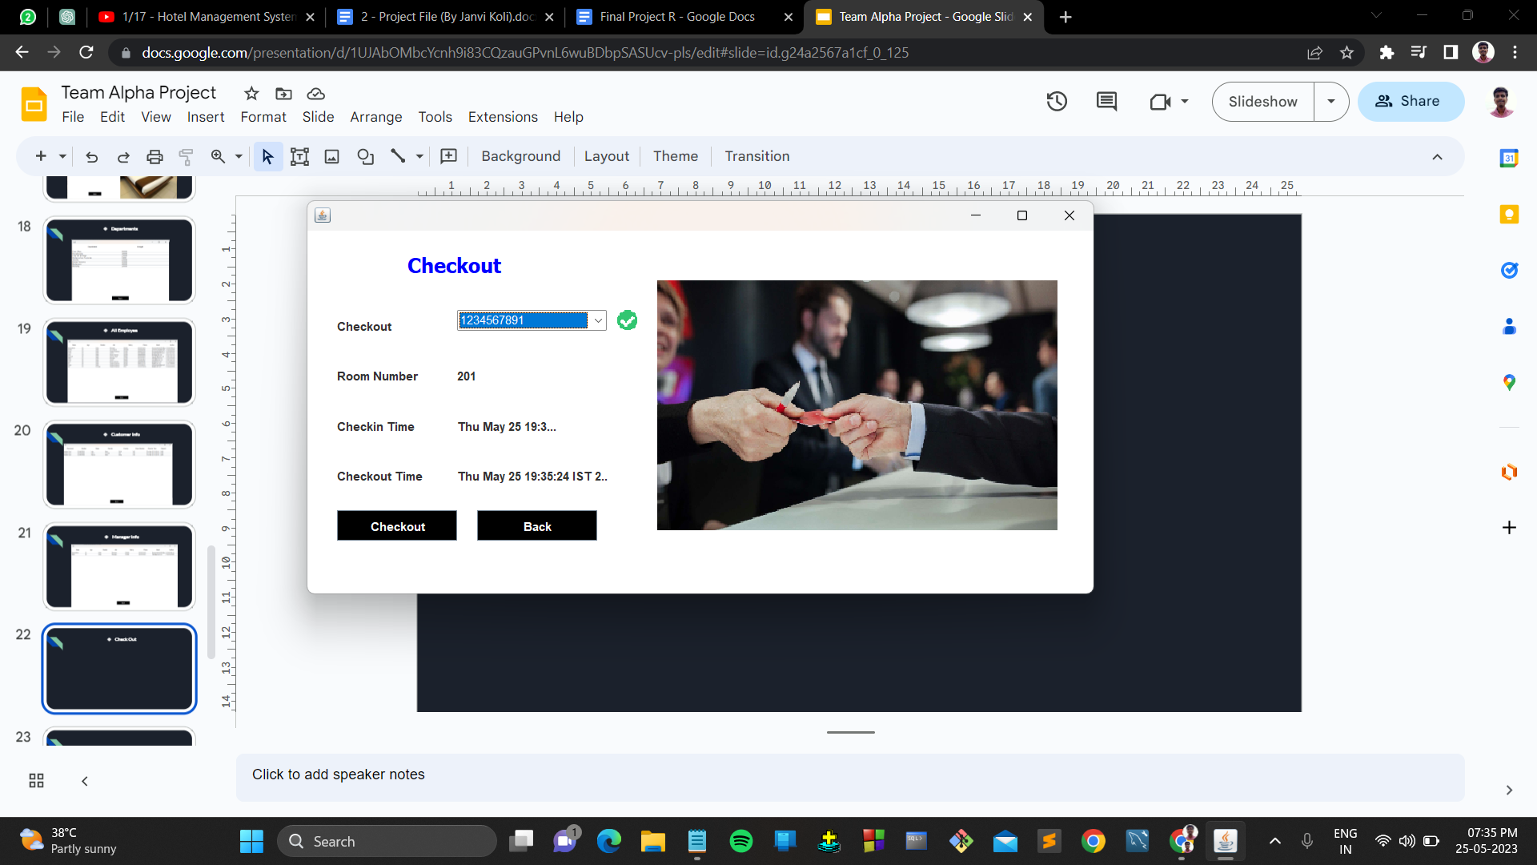
Check Out

Slide 23
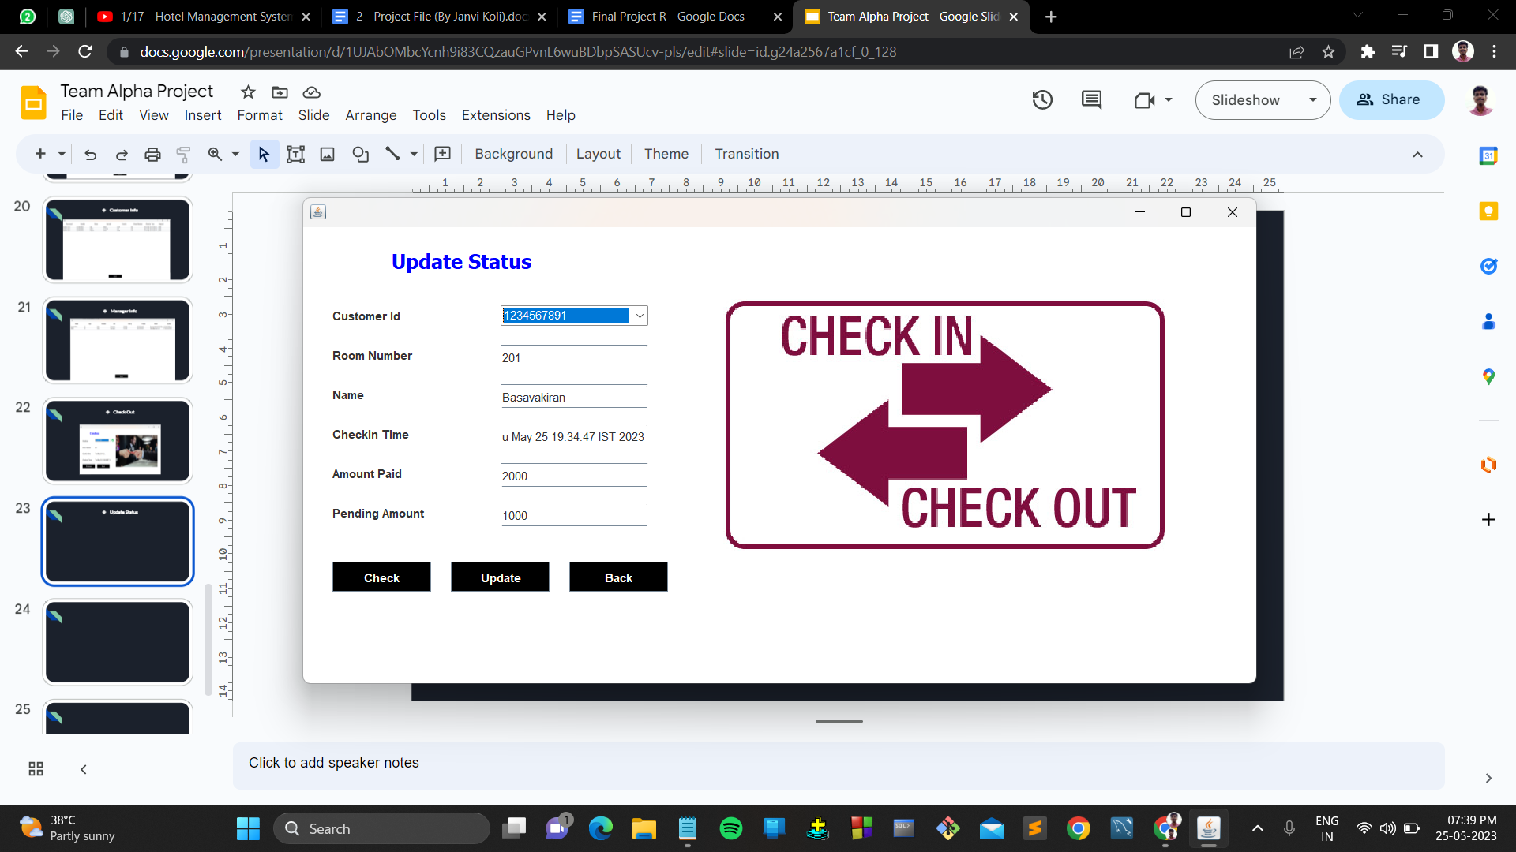
Update Status

Slide 24
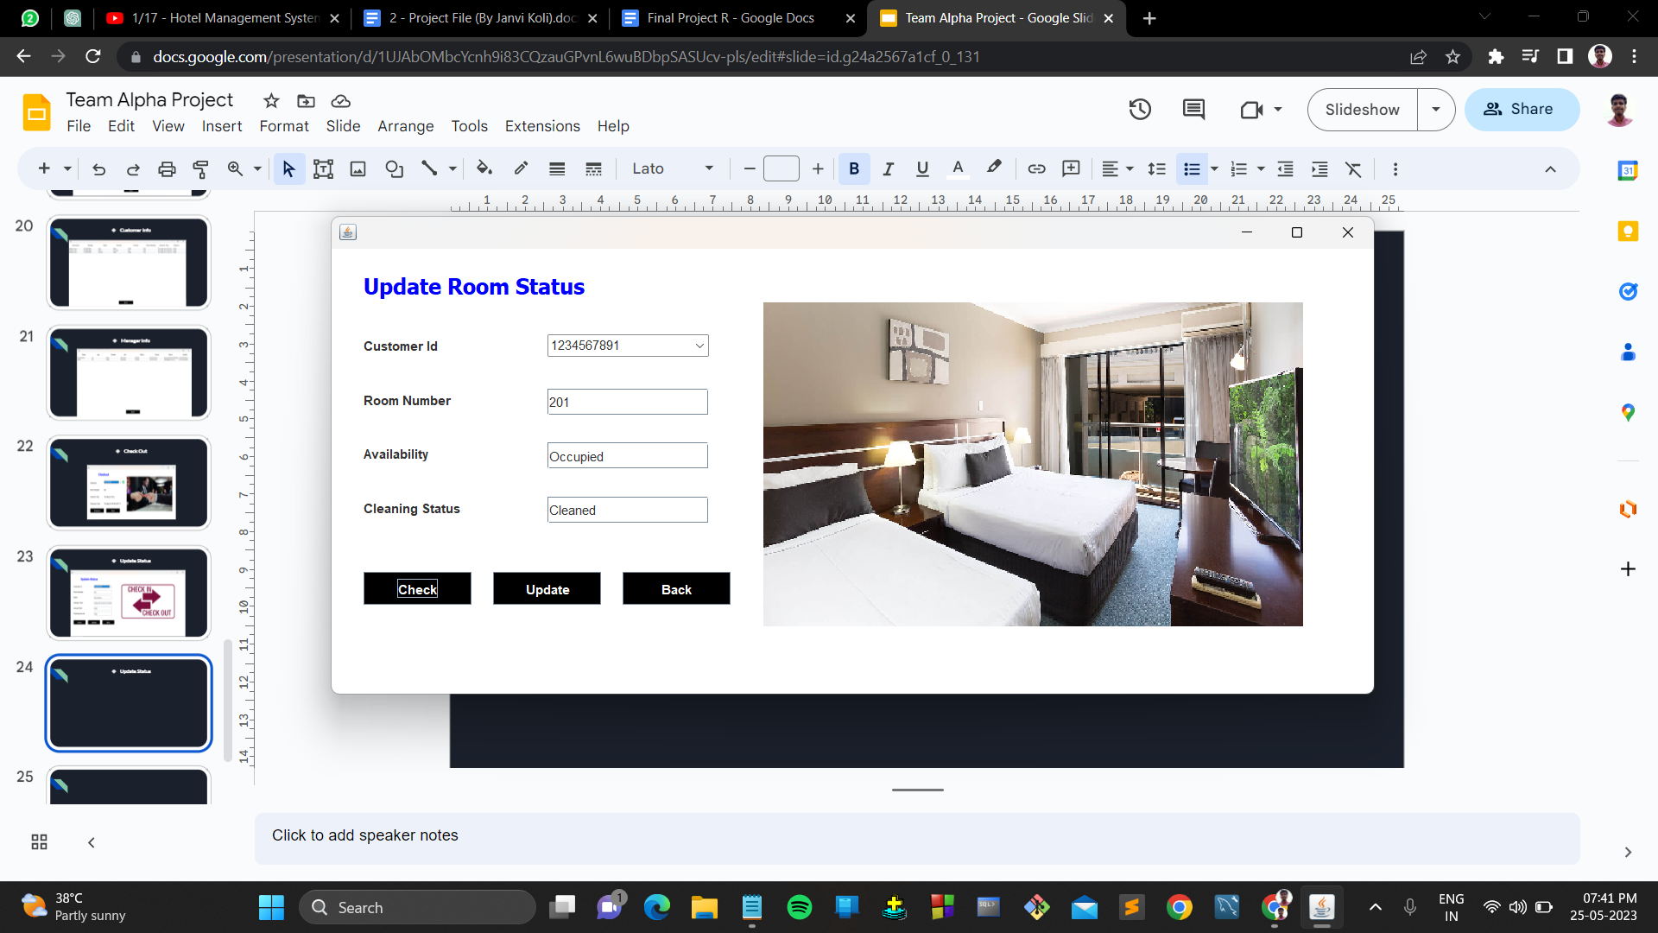
Update Room Status

Slide 25
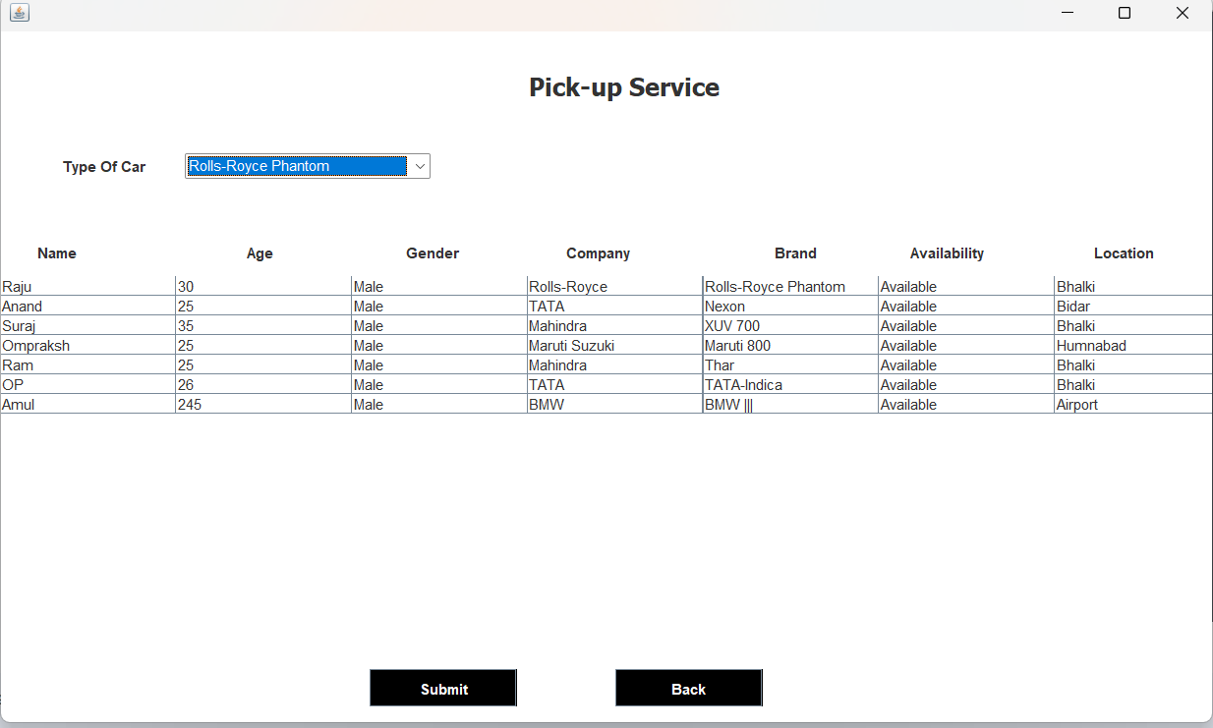
Pick-up Service

Slide 26
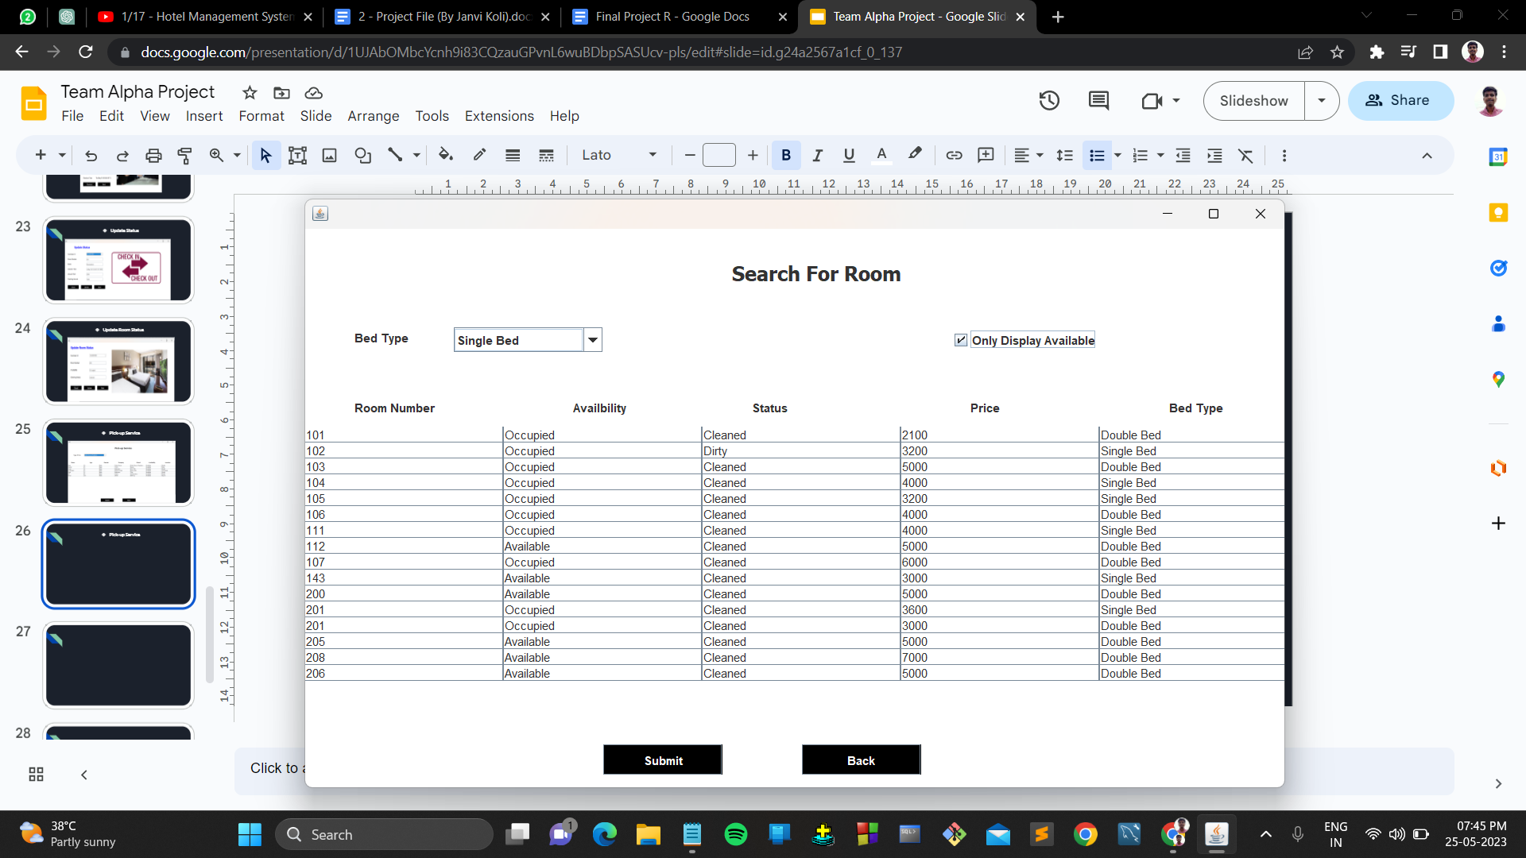
Search For Room

Slide 27
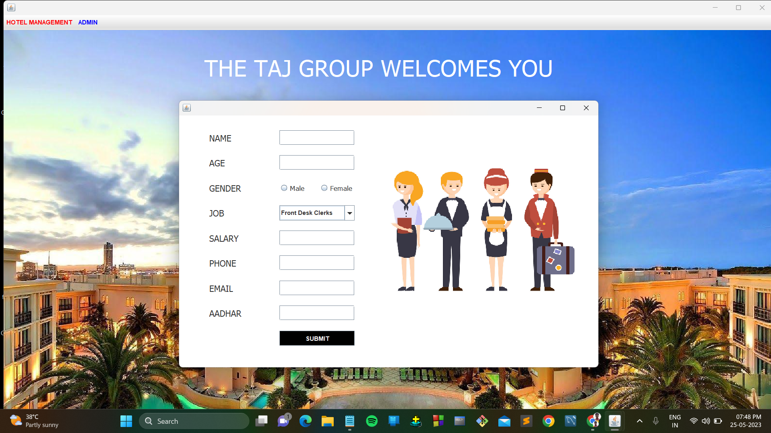
Add Employee

Slide 28
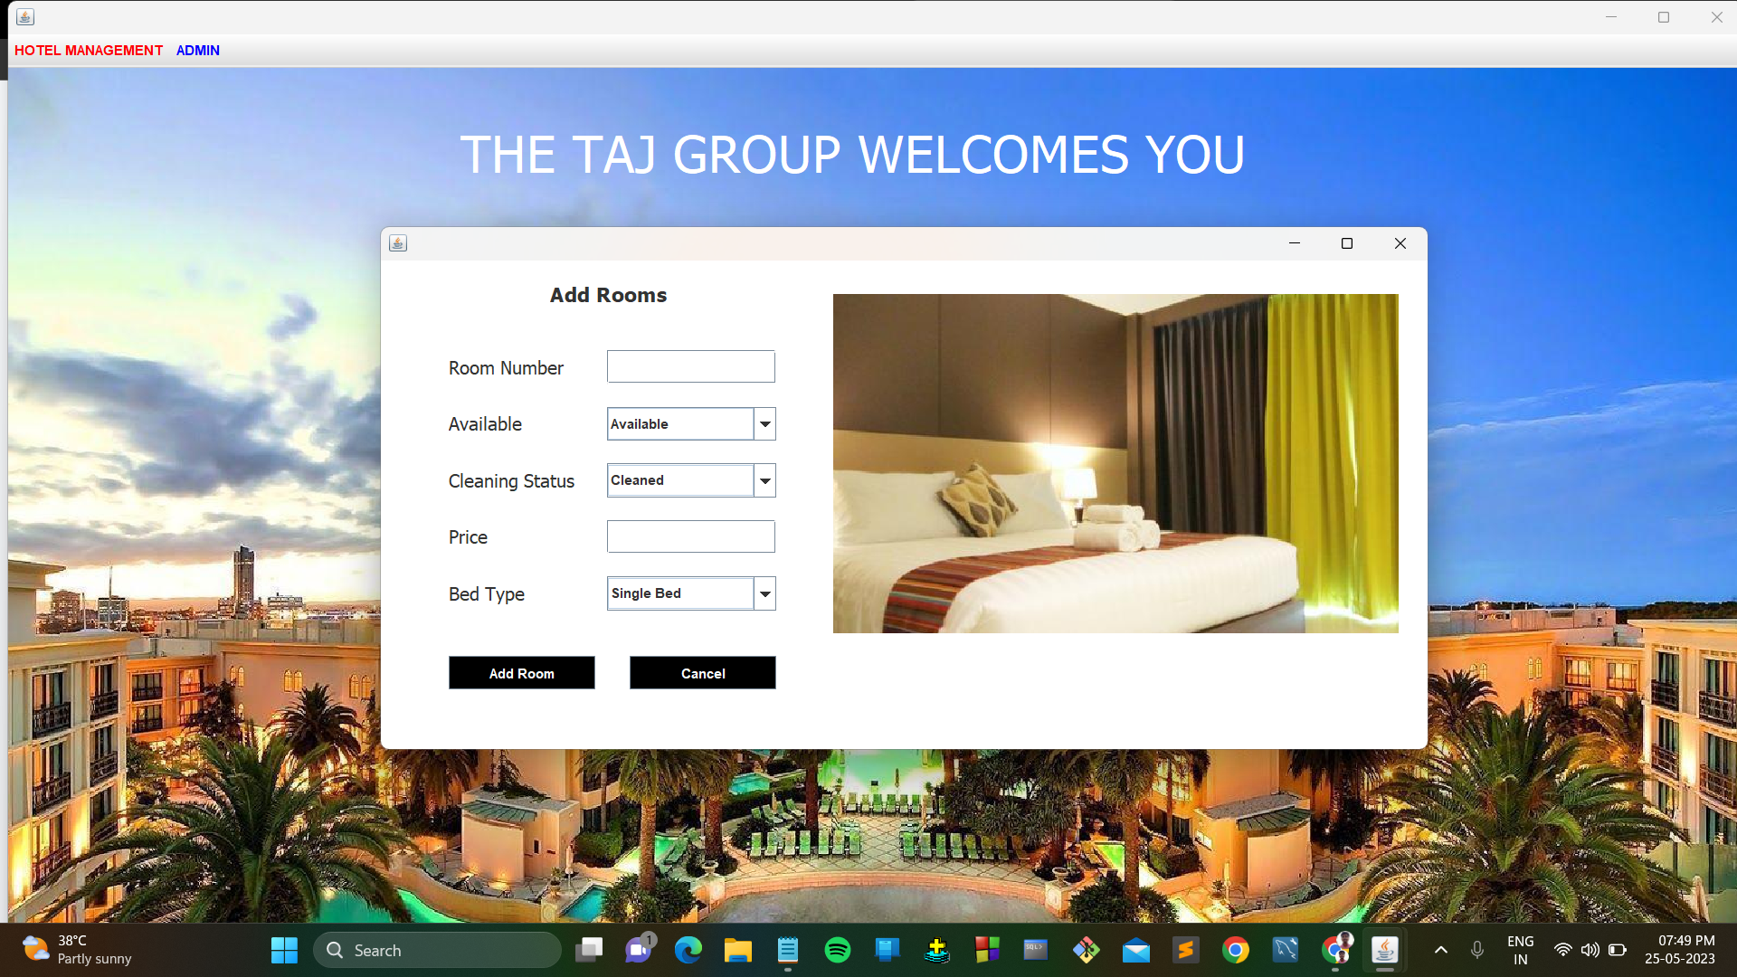
Add Rooms

Slide 29
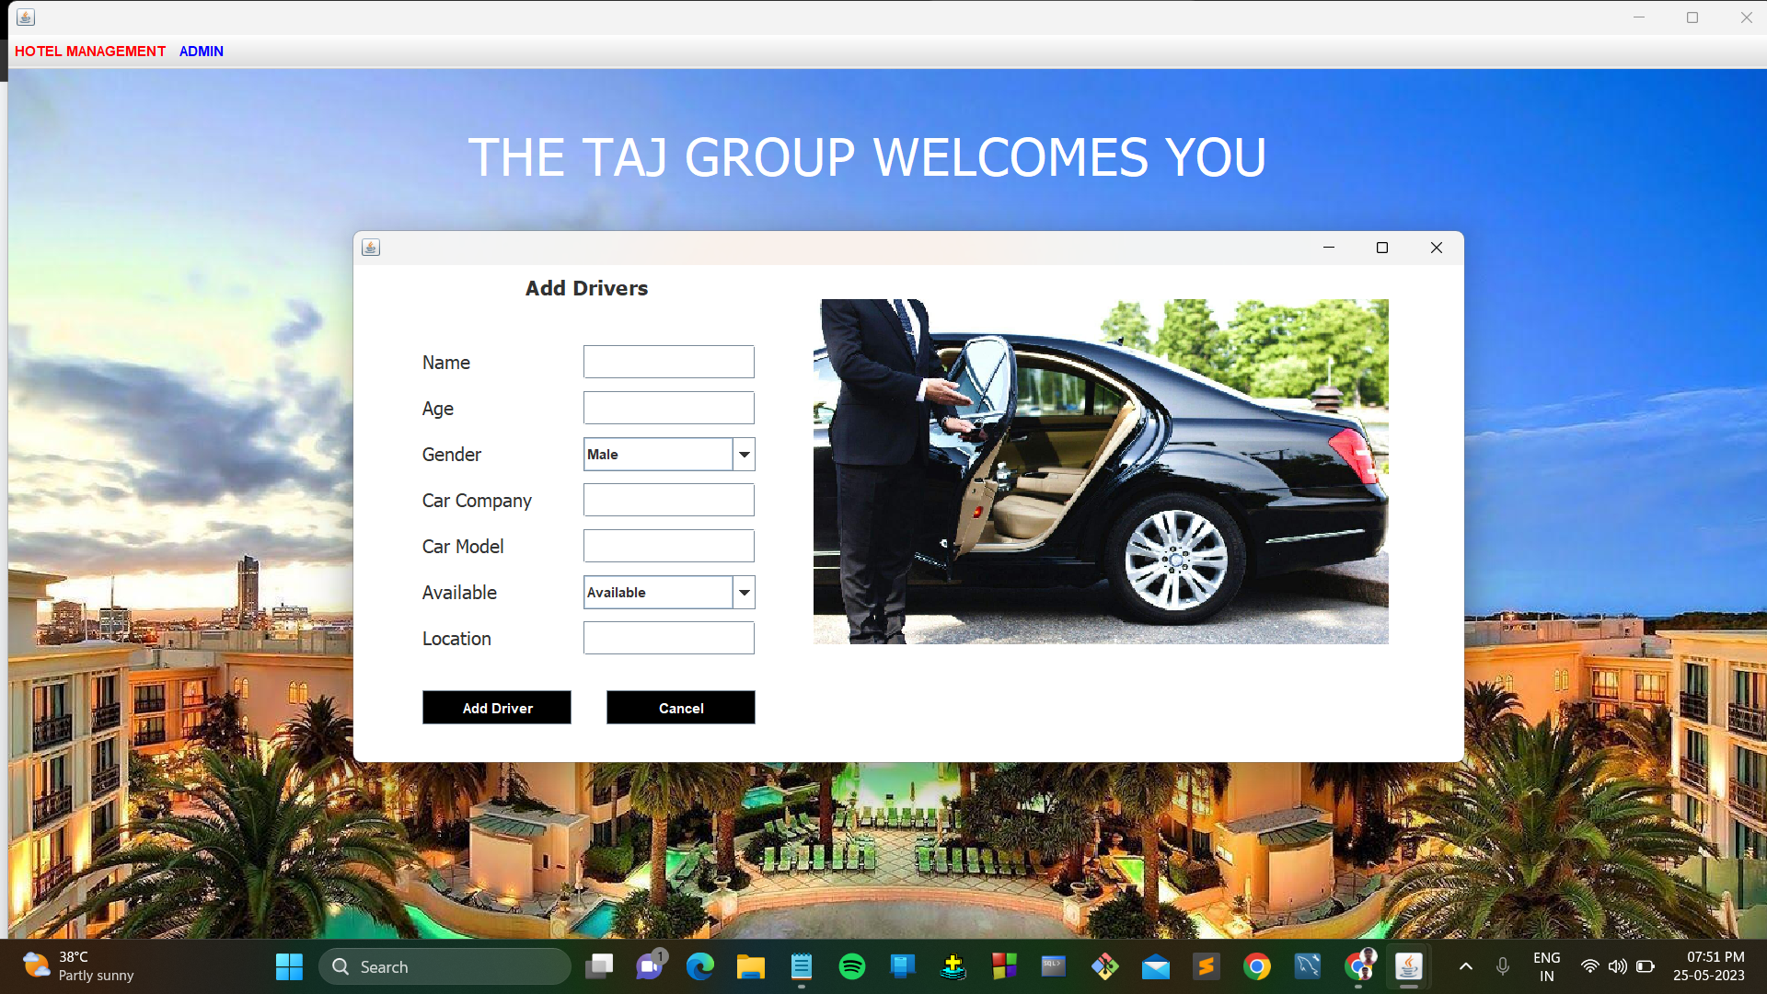
Add Drivers

Slide 30
Future Scope
Today hotel management is not only confined to hotels but has gone deep into tourism, catering, clubs, etc making it a very paying and an exciting career option.
With the rapid growth of the hotel industry pushed forward by foreign and domestic tourism and business travels, the demand for well trained and quality personnel too has gone up high.
India is one of the preferred tourist and travel destinations. Approx 4.4 million tourists visit our country every year.
At present, there are about 200 millions of jobs available in the industry, out of which 20% of the job opportunities are in India.

Slide 31
Conclusion
Hotel Management System project aimed to streamline and automate various aspects of hotel operations, specifically focusing on the admin and reception modules.
Through the implementation of this project, it was possible to enhance the overall efficiency and effectiveness of hotel management tasks.
The use of databases facilitated data storage and retrieval, allowing for easy access to customer details, room information, employee records, and other relevant data.
It also provided a foundation for further enhancements and customization based on specific hotel management requirements.

Slide 32
Reference
Core Java Volume I - Fundamentals (11th Edition) - 3 July 2020
Java Swing, 2nd Edition by Dave Wood, Robert Eckstein, Marc Loy, James Elliott, Brian Cole - 29 November 2002
Efficient MySQL Performance: Best Practices and Techniques by Daniel Nichter - 21 December 2021
Chhikara, S., & Verma, R. (2016). Design and Implementation of Hotel Management System. International Journal of Computer Science and Information Technologies, 7(2), 738-743.
Singh, H., Singh, G., & Kaur, R. (2018). Hotel Management System: A Case Study. International Journal of Computer Science and Mobile Computing, 7(10), 107-112.

Slide 33


